Slide 1
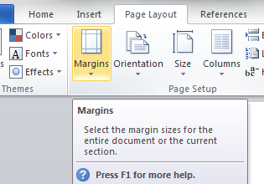
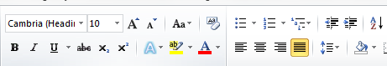

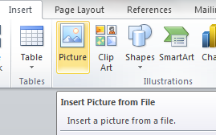
Chapter 17: Document Production (Word)
Task 1 - Smartphone wars: Apple v Samsung
Page Layout Change the page Orientation from Landscape to Portrait. Set the following Margins – Right & Left – 1.2 Top & Bottom – 1 Insert your name in the Header (Top Right) Insert the Page Number in the Footer (Centre)
Text Formatting Create the text styles shown above. Apply the Title style to the main title (Smart Phone …..) Apply the Body Text style to the remaining text. Format the Text below the title so that it is into three columns.
Enter and edit data from different sources Insert the Samsung image in the first paragraph from the second column. Resize the image so it is aligned to the left of the margin and the height is 2.5CM (maintain aspect ratio). Format the picture so it is wrapped tight around the text.
House Style Specification Sheet Title: Sans Serif, Red, Bold, 20 pts, centre aligned Body Text: Serif, Black, 1.5 line spacing, 12 pts and Justified. Line space after each paragraph.

